Slide 1
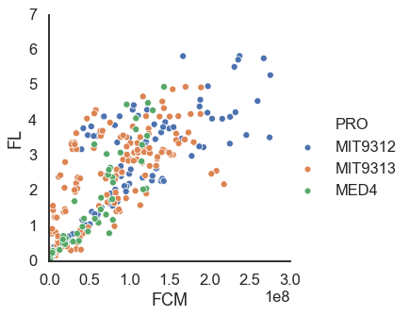
FCM vs FL in other experiments
R² = 0.85

Slide 2
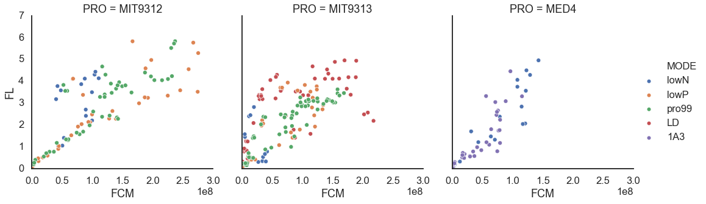
R² = 0.88
R² = 0.82
R² = 0.92

Slide 3
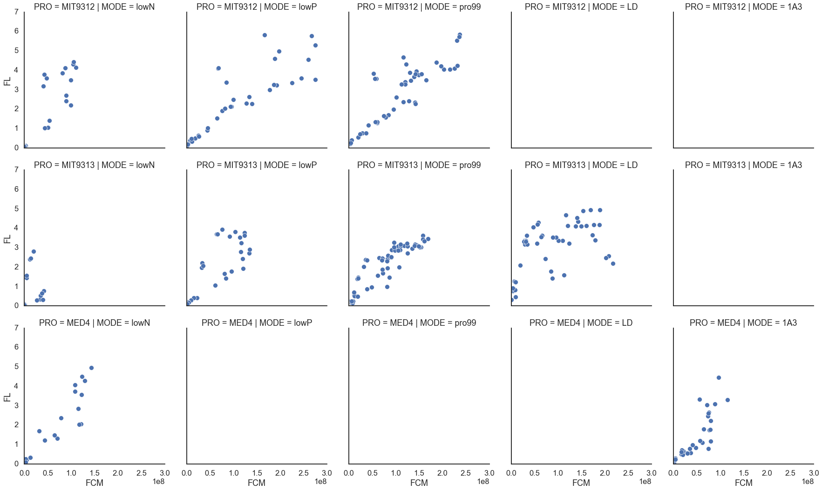
R² = 0.88
R² = 0.88
R² = 0.93
R² = 0.22
R² = 0.86
R² = 0.94
R² = 0.74
R² = 0.94
R² = 0.86

